Slide 1
Resume Classification
Group 4

Slide 2
Business objective-
Aim is to obtain solution that should significantly reduce the manual human effort in the HRM.
It should achieve a higher level of accuracy and automation with minimal human intervention

Slide 3
Data Extraction
Data is extracted from .docx, .pdf and .doc files and a data frame is generated with 4 columns.
Preprocessing on this data is performed
Null entries
Duplicate entries
Missing entries
There are totally 79 resumes from 4 different companies in the dataset.
Peoplesoft resumes
React JS Developer
SQL Developer Lightning insight
workday resumes

Slide 4
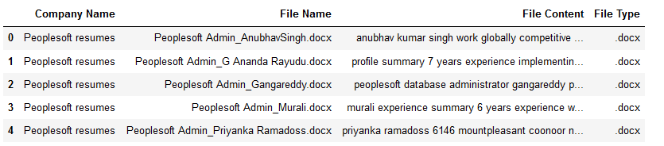
Data Preprocessing
Convert the entire resume text to lowercase to make it case-insensitive:
Remove Special Characters
Tokenization
Remove Stopwords
Join Words Back to Text

Slide 5
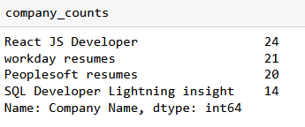
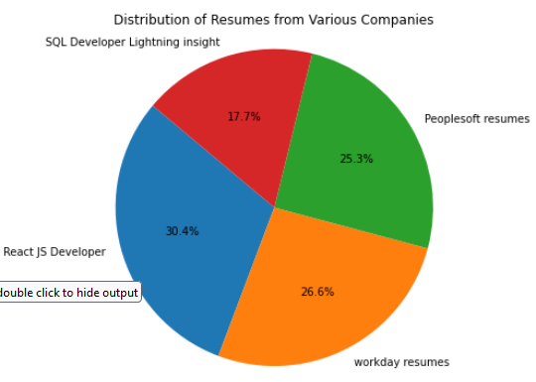
EDA- 1. Resume distribution across companies

Slide 6
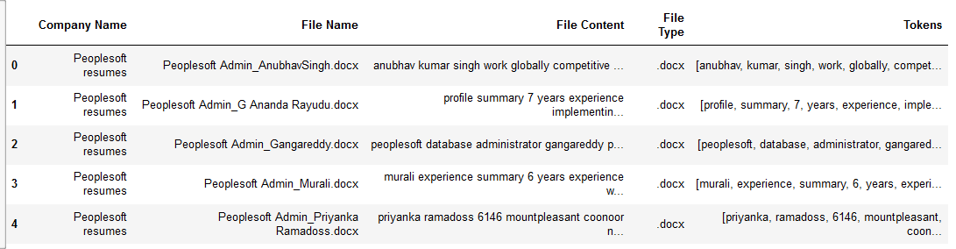
EDA- 2. Word Frequency Analysis:

Slide 7
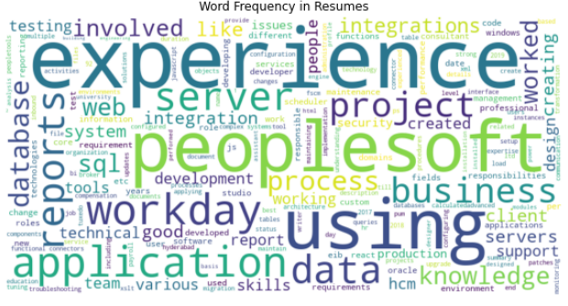
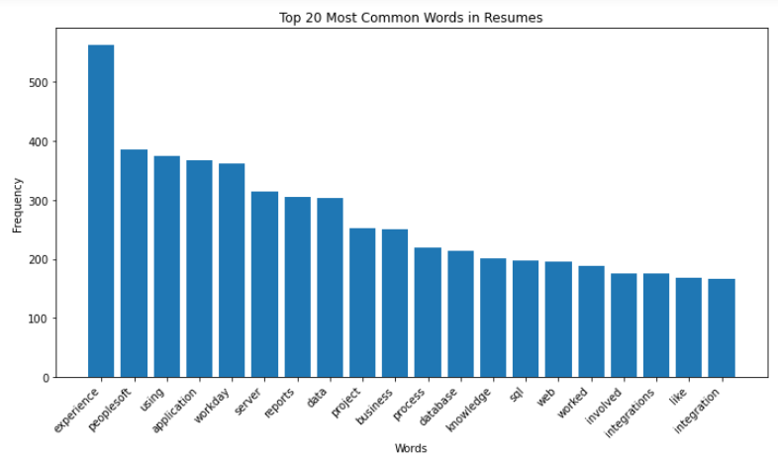

Slide 8
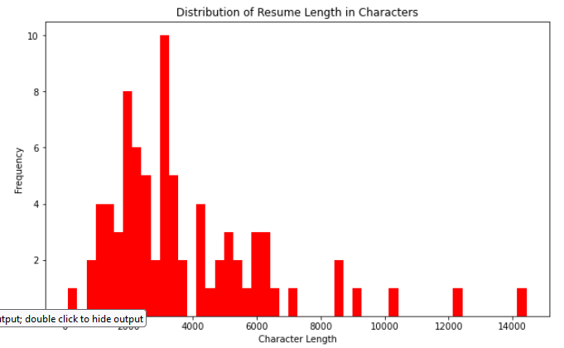
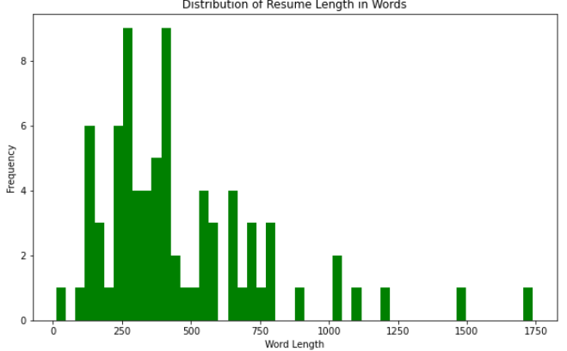
EDA- 3. Resume Length Analysis:

Slide 9
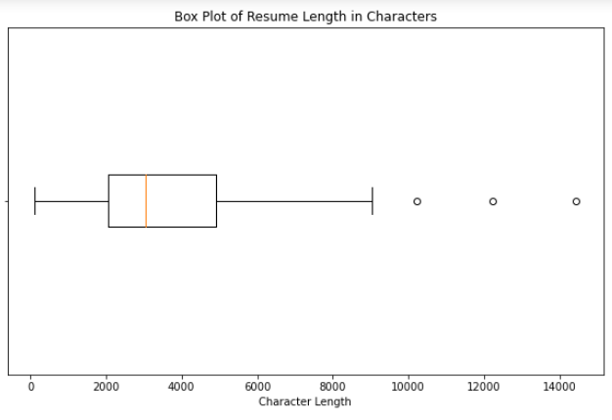
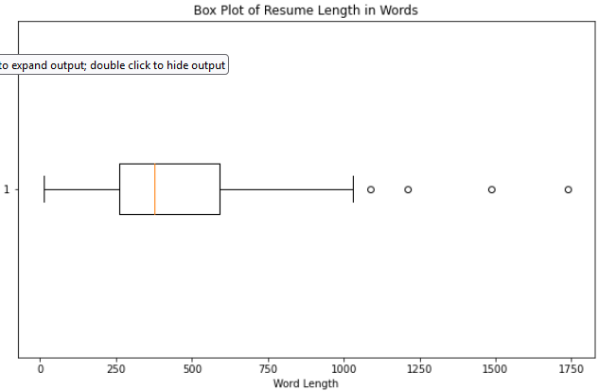

Slide 10
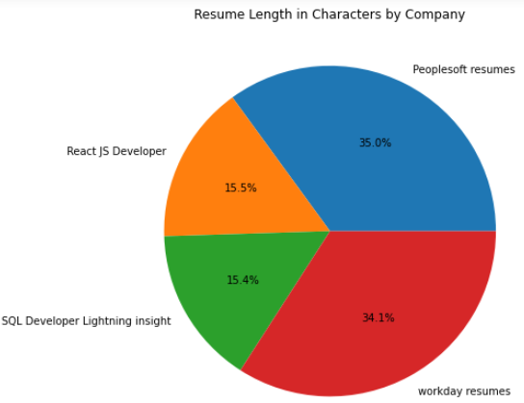
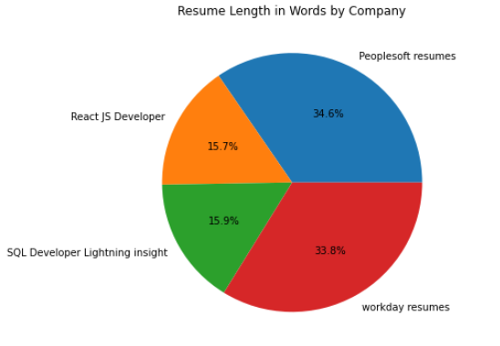

Slide 11
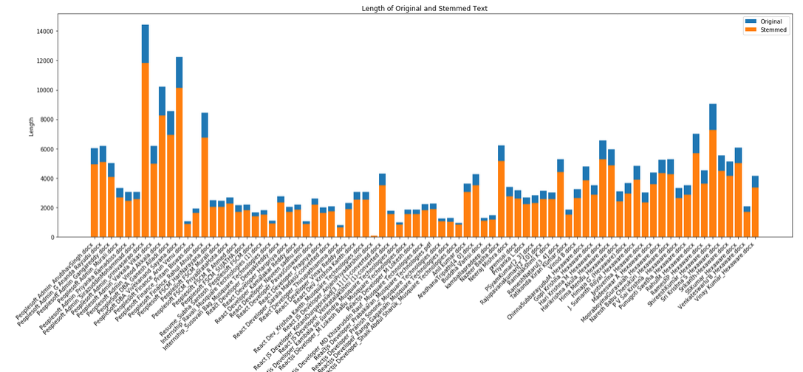
EDA- 4. Stemming Analysis:

Slide 12
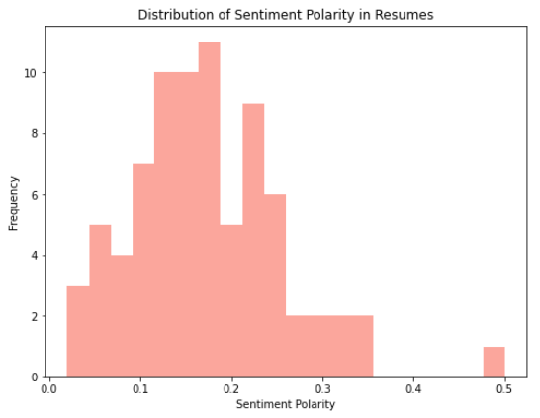
EDA- 5. Sentiment Analysis:

Slide 13
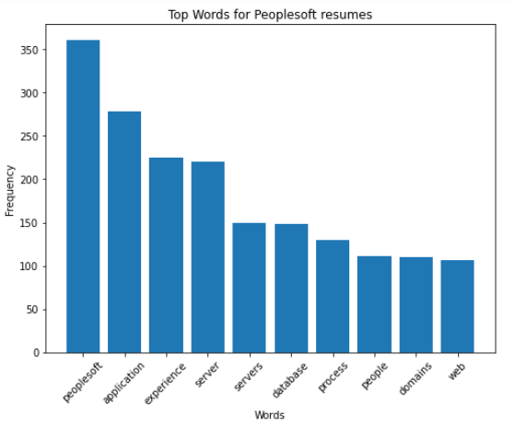
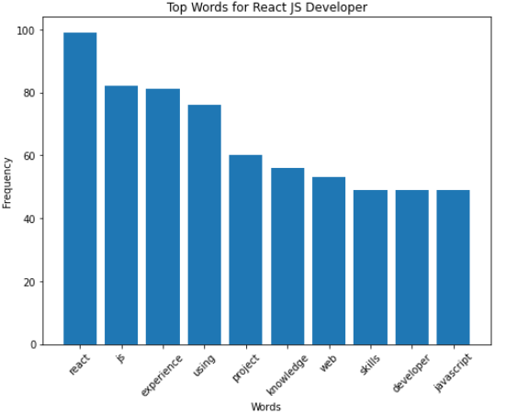
EDA- 6. Top Words by Company:

Slide 14
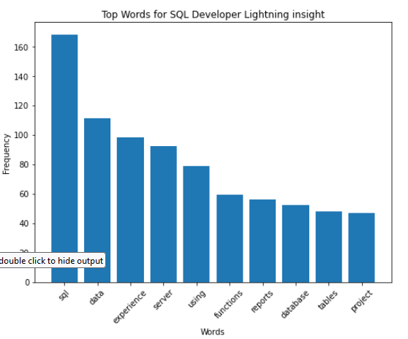
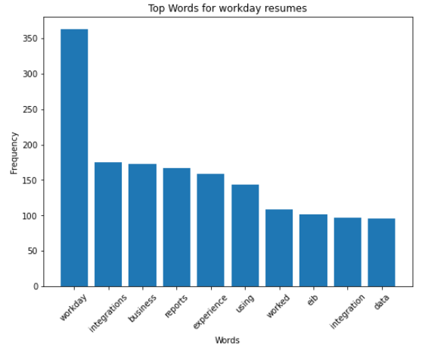

Slide 15
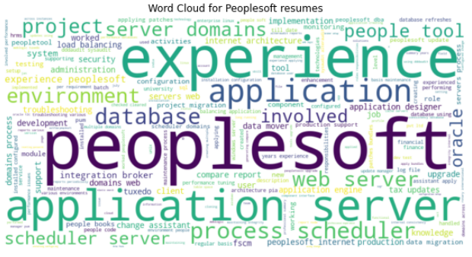
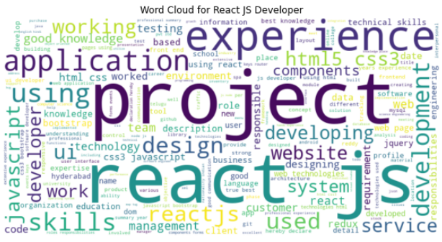
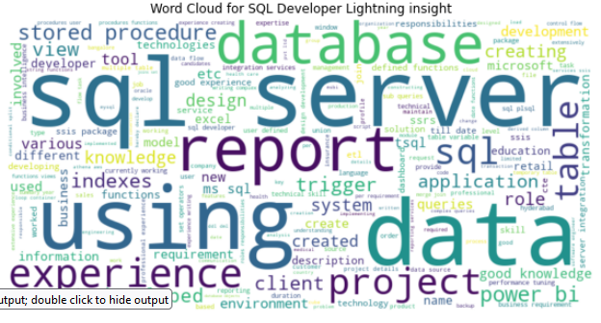
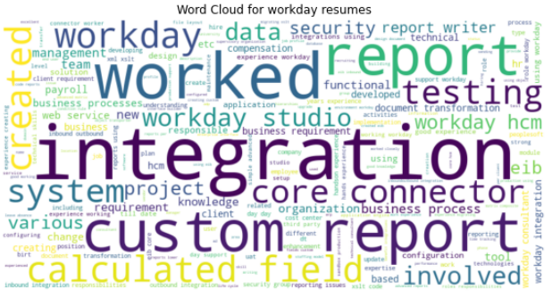

Slide 16
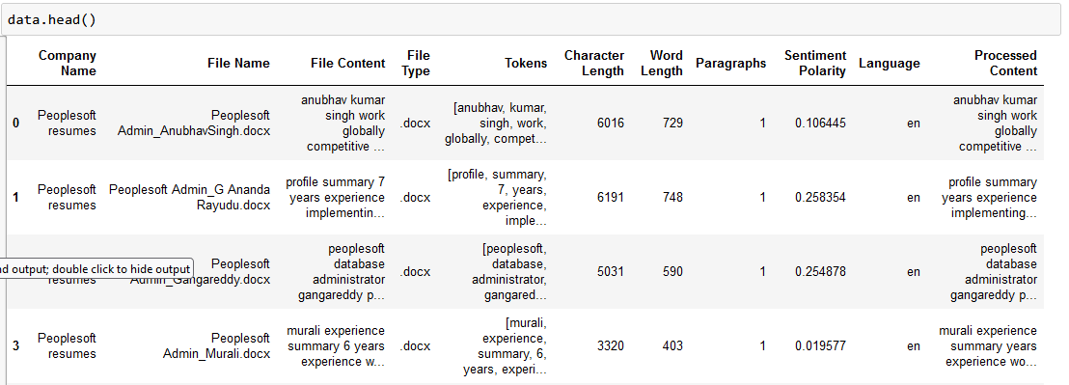
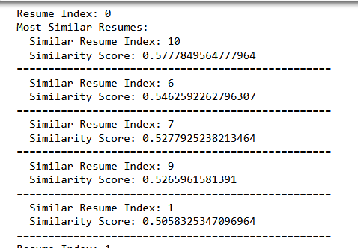
EDA- 7. Resume Similarity Indexing:
After Processing the File Content column from the data frame, the similarity indexing is performed to obtain the similarity scores.

